Slide 1


Amazon Fresh Analytics

Slide 2
TABLE OF CONTENT:
Data Modeling and Basic Queries
Data Definition Language (DDL) and Constraints
Data Manipulation Language (DML)
SQL Constraints and Operators
Clauses and Aggregations
Complex Aggregations and Joins’
Normalization
Subqueries and Nested Queries
Real-World Analysis

Slide 3
Problem Statement:
Amazon Fresh is an e-commerce platform specializing in groceries and daily essentials. As the platform expands, its management seeks to optimize operations, enhance customer satisfaction, and boost revenue. The challenge lies in effectively managing large volumes of data, including customer profiles, product inventories, supplier information, orders, and customer reviews. The problem is to design a relational database for Amazon Fresh that organizes this data efficiently, allows for meaningful analysis, and supports critical business decisions. This project aims to solve key business problems, such as identifying top-performing products, analyzing customer purchasing patterns, and ensuring inventory management aligns with demand trends.

Slide 4
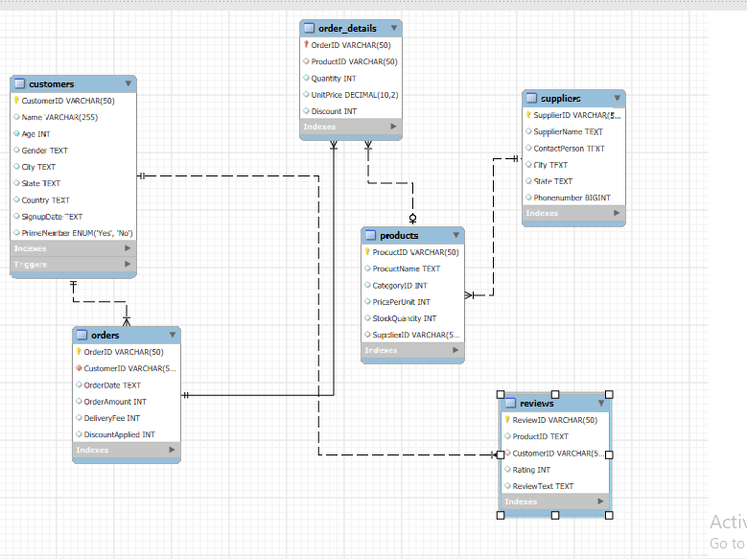
Data Modeling and Basic Queries
Task : 1
Create an ER diagram for the Amazon Fresh database to understand the relationships between tables (e.g., Customers, Products, Orders). Created Diagram by setting the appropriate primary keys and foreign keys in Mysql workbench

Slide 5
Task : 2
Identify the primary keys and foreign keys for each table and describe their relationships.
Findings:
Primary keys
Foreign keys
Customers (CustomerID)
Orders (OrderID)
Order_Details (OrderID, ProductID) (Composite Primary Key)
Products (ProductID)
Categories (CategoryID)
Suppliers (SupplierID)
Customers → Orders
Orders.CustomerID should reference Customers.CustomerID
Orders → Order_Details
Order_Details.OrderID should reference Orders.OrderID
Products → Order_Details
Order_Details.ProductID should reference Products.ProductID
Products → Categories
Products.CategoryID should reference Categories.CategoryID
Products → Suppliers
Products.SupplierID should reference Suppliers SupplierID

Slide 6
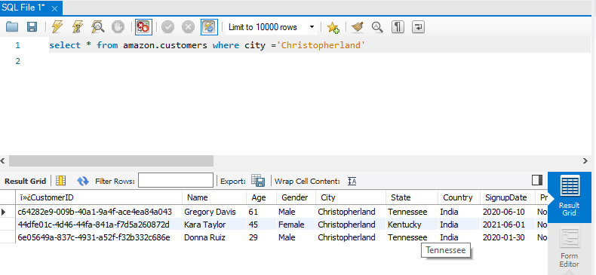
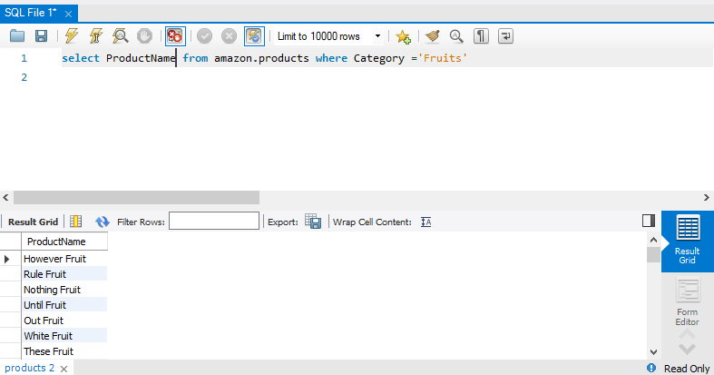
Task : 3
Retrieve all customers from a specific city.
Output: Retrieved all the customers from a “Christopher land” city from customer table using the SELECT command & Where clause in MYSQL
Write a query to:
Fetch all products under the "Fruits" category.
Output: Collected all the products under the fruits category from product table using the SELECT command & Where clause

Slide 7
DATA DEFINITION LANGUAGE (DDL) AND CONSTRAINTS
Task : 4
Write DDL statements to recreate the Customers table with the following constraints:
CustomerID as the primary key.
.
Insights : Set the customer ID as primary key Ensures each CustomerID is unique using the query so it cannot be NULL
Ensure Age cannot be null and must be greater than 18
Insights:
While checking the age condition is filed, I have received errors because some of the customer age is below 18 then updated the age of the customers to 19 those who have below 18 using the query follows the UPDATE commands. Then used a trigger to prevent inserting invalid ages in future.
Add a unique constraint for Name.
Insights:
To prevent duplicate names in the Customers table, we add a Unique Constraint for name. This ensures that no two customers have the same name.

Slide 8
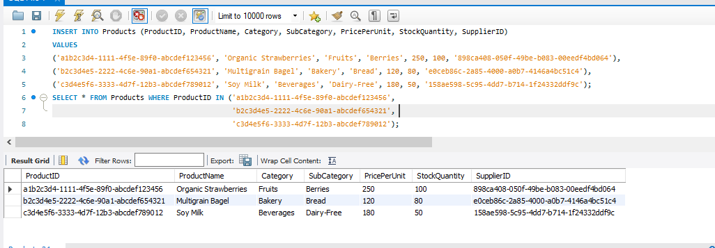
• Data Manipulation Language (DML)
Task : 5
Insert 3 new rows into the Products table using INSERT statements.
Insights: It ensures that new data is properly categorized using the INSERT statement included 3 rows into product table. Also, I made sure that 3 random values of SupplierID added in the Suppliers table.

Slide 9
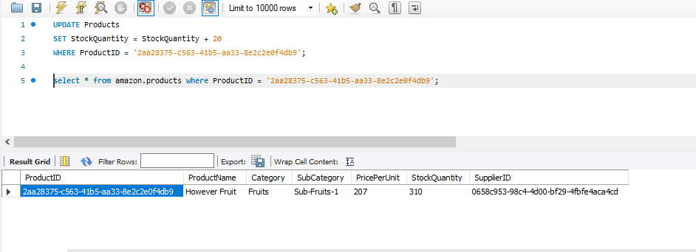
Task : 6
Update the stock quantity of a product where ProductID matches a specific ID.
Procedure: To update the stock quantity: For instance increased the stock by 20 for a product with ProductID = '2aa28375-c563-41b5-aa33-8e2c2e0f4db9’ using the UPDATE statement.
Insights: It has been increased from 187 to 207 after performing the UPDATE statement.

Slide 10
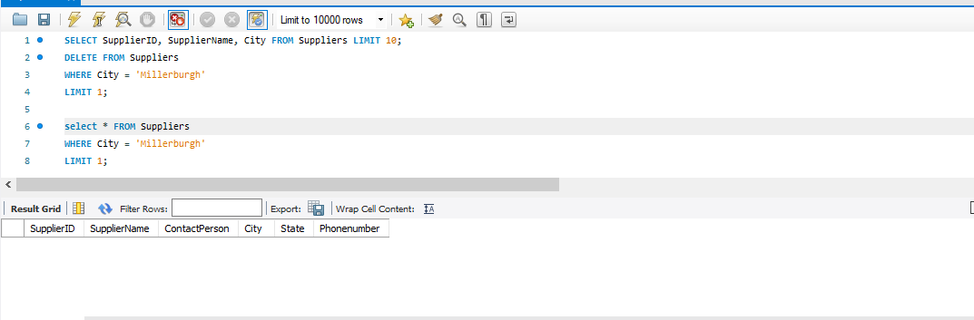
Task : 7
Delete a supplier from the Suppliers table where their city matches a specific value.
Have to delete one supplier from the suppliers table based on random matched city. There were only one supplier from Millerburgh.
I have deleted that supplier who from “Millerburgh” using the delete command.

Slide 11
SQL Constraints and Operators
Task : 8
Use SQL constraints to:
1. Add a CHECK constraint to ensure that ratings in the Reviews table are between 1 and 5.
Insights: The purpose of CHECK constraint is rating should be given within 5. Hence, the constraint will prevent inserting values outside this range
2. Add a DEFAULT constraint for the PrimeMember column in the Customers table (default value: "No").
Insights: The purpose of DEFAULT constraint is set a specific value Here the value is “no” for prime member. Also, The datatype used here is “ENUM” which means it allows only specific value to be inserted in the column

Slide 12
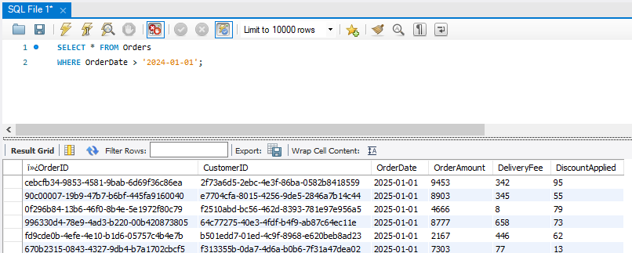
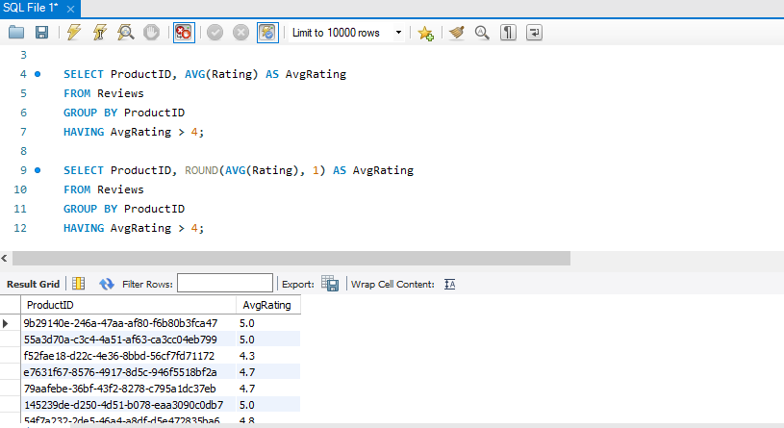
Clauses and Aggregations
Task : 9
Write queries using:
WHERE clause to find orders placed after 2024-01-01.
Insights: The purpose of WHERE clause is to filter the records Here, we have filtered the orders placed after “2024-01-01” using the WHERE clause generally using for row level filtering.
HAVING clause to list products with average ratings greater than 4.
Insights: Having clause is mainly used to filter aggregated column. Here, Filters products where the average rating is greater than 4. Here, it helps identify top-rated products, which can be promoted more or recommended to customers.

Slide 13
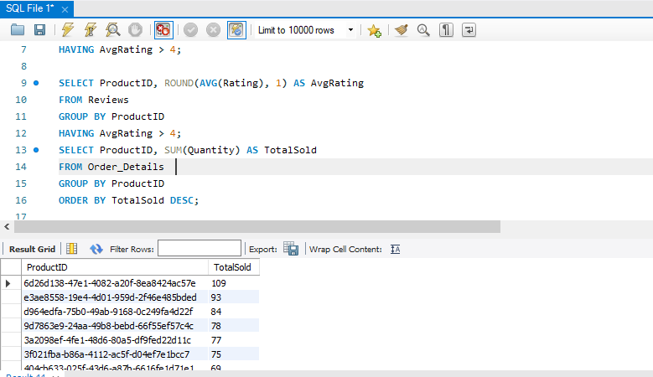
GROUP BY and ORDER BY clauses to rank products by total sales
Insights:
GROUP BY clause is used to group rows that have the same values in specified columns. It is typically used with aggregate functions. ORDER BY clause is using for sort the results in Asc or Desc order.
Here, we have Grouped products by ProductID, sums total quantity sold, and orders them from highest to lowest sales
It helps to identify best-selling products..

Slide 14
Identifying High-Value Customers
Task : 10
Scenario: Amazon Fresh wants to identify top customers based on their total spending. We will:
Calculate each customer's total spending.
Procedure: Using the function SUM: Multiplies the quantity of each product ordered Quantity by its price.Sums up the total spending per customer. GROUP BY o.CustomerID: Groups the result by each customer to get individual total spending.
Insights: This helps to understand which customers contribute the most revenue.
Rank customers based on their spending.
Procedure: Calculates total spending per customer by multiplying Quantity with PricePerUnit from the Products table. Groups the data by CustomerID. Selects CustomerID, TotalSpending, and assigns ranks based on TotalSpending (highest spending gets Rank 1)
Insights: We can identify top customers also it Allows comparisons between top spenders and occasional buyers.

Slide 15
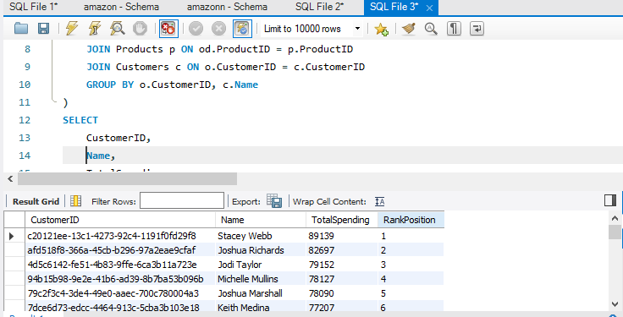
OUTPUT:

Slide 16
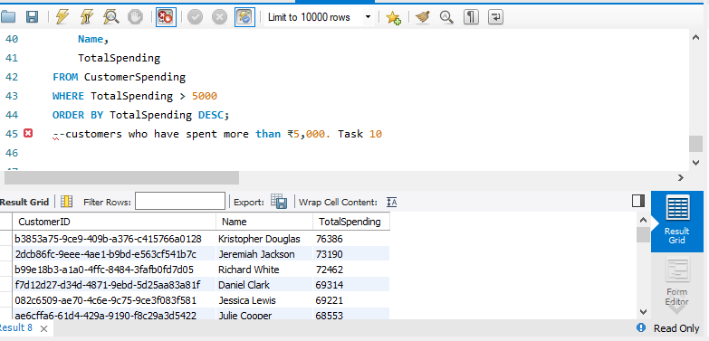
Identify customers who have spent more than ₹5,000
Procedure: To identify who have spent more than 5000, Multiplied Quantity (from Order_Details) with PricePerUnit (from Products).Sum this amount per CustomerID. Use WHERE TotalSpending > 5000 to keep only those who spent more than ₹5,000.Sort the Output to see the highest spenders first.
Insights: It helps in customer retention strategies by offering personalized benefits to develop the business.

Slide 17
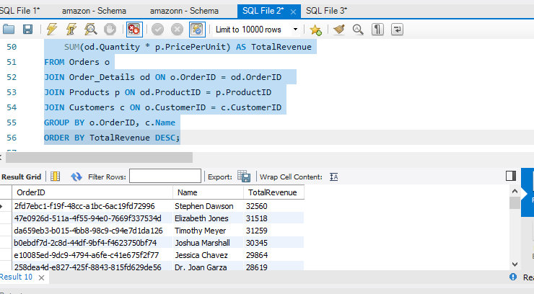
Complex Aggregations and Joins
Task : 11
Join the Orders and Order_Details tables to calculate total revenue per order.
Procedure: Total revenue per order can be calculated using the Order_Details table by multiplying Quantity * PricePerUnit and grouping by OrderID.
Insights: We can identify peak order trends for better demand forecasting and helps in discount strategy planning for large orders.

Slide 18
Identify customers who placed the most orders in a specific time period.
Insights: Here, we have filtered orders based on a date range and count the number of orders per customer. It has given us the result that customer(Madeline Martin) has placed the most orders for the year 2025. Tracking orders over time helps identify loyal and frequent buyer
Find the supplier with the most products in stock.
Procedure: By using the query: sum the stockquantity of all products supplied by each supplier. Group by supplierid, suppliername to calculate total stock for each supplier. Sort by totalstock DESC so the supplier with the most stock appears first. Used LIMIT 1 to get only the top supplier.
Insights: We have identified ” Diaz white” supplier has the highest number of products in stock. Helps identify reliable suppliers for bulk restocking. Reduces out-of-stock issues by strengthening supplier relationships.

Slide 19
Normalization
Task : 12
Normalization is the process of structuring a database to reduce redundancy and improve integrity.
Separate product categories and subcategories into a new table.
Create foreign keys to maintain relationships.
Procedure: Created a new table ProductCategories to store categories and subcategories also, removed Category and SubCategory from the Products table. Linked the categoryID into foreign key.
Insights: Any category or subcategory update affects only one table. Searching for products based on categories is quicker. New categories can be added without modifying the Products table.

Slide 20
Subqueries and Nested Queries
Task : 13
Identify the top 3 products based on sales revenue
Procedure: To find the top 3 products based on revenue first have to calculates total revenue (Quantity * Unit Price) for each product and using the order by and group by function, picked the top 3 highest-selling products.
Insights: We have found that top 3 selling product is Capital snack, society vegetable, Fish dairy which Helps to offer discounts or promotions on high-revenue items and supports forecasting demand for popular products
Find customers who haven’t placed any orders yet.
Findings: We Found customers whose CustomerID does not exist in the Orders table, which means result of people(Erica Huber, William cubings etc…) who have never placed an order using the query.
Insights: It will useful to target inactive customers for marketing campaigns and encourage them by giving discounts and cashbacks.

Slide 21
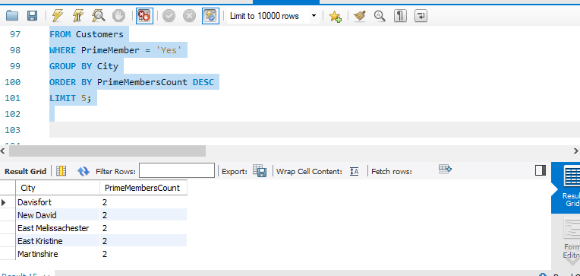
Real-World Analysis
Task : 14
Provide actionable insights:
Which cities have the highest concentration of Prime members?
Procedure :At first, filters only Prime members and Groups results by city. Counts the number of Prime members in each city Sorts cities from highest to lowest concentration of Prime members.
Insights: It will be useful for expanding delivery infrastructure in high-demand areas and for advertisment

Slide 22
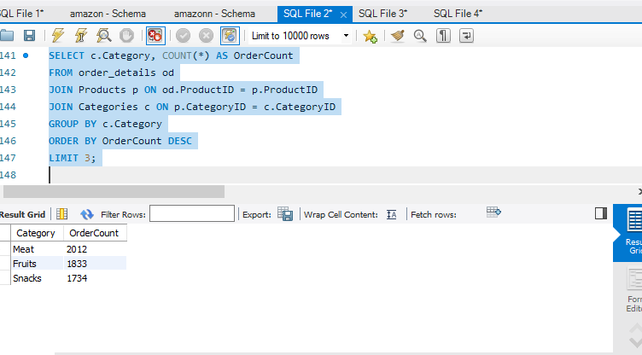
What are the top 3 most frequently ordered categories?
Procedure: To find the top 3 category need to Joins order_details, Products, and Categories to get category names. Counts the number of times a category appears in orders and Groups by category name. Orders the result in descending order Limits the output to the top 3 categories.
Insights: Top 3 frequently ordered categories are Meat , fruits and snacks. We can analyze the trend for future inventory planning.

Slide 23

Thank You

